Slide 1

A Hitchhiker’s Guide to the Quantum World
Team BeautifulSoup
Christopher Gundler
Philipp Fukas
Jonas Rebstadt
Farina Kock
Christoph Stenkamp

Slide 2
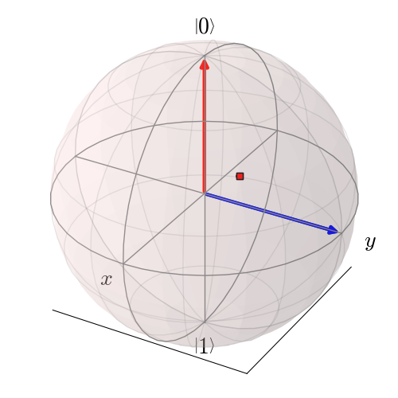
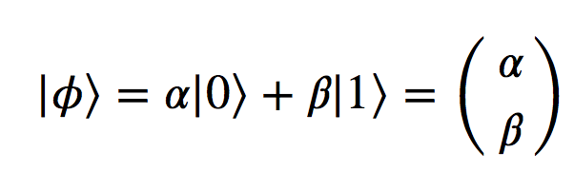
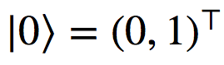
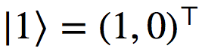
Introduction to Qubits
A qubit is a two-dimensional quantum-mechanical system that is in a state
with
and
Measuring the qubit leads to the classical bit
0 with probability |α|² ,
1 with probability |β|²
Bloch sphere representation

Slide 3
Superposition and Entanglement
Two quantum mechanical effects that can outperform classical algorithms are:
superposition and entanglement
each qubit is in both states simultaneously
(before measurement)
type of correlation between two or more qubits

Slide 4
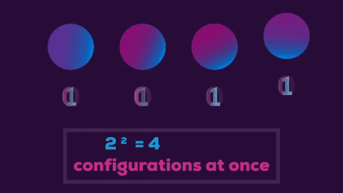
Why may a quantum computer be faster?
Quantum computers allows more efficient algorithms → massive parallelism
Until now: Speed-up “proven” by complexity theory, not by real-life experience
Notes:
Still open questions: NP = P?!

Slide 5
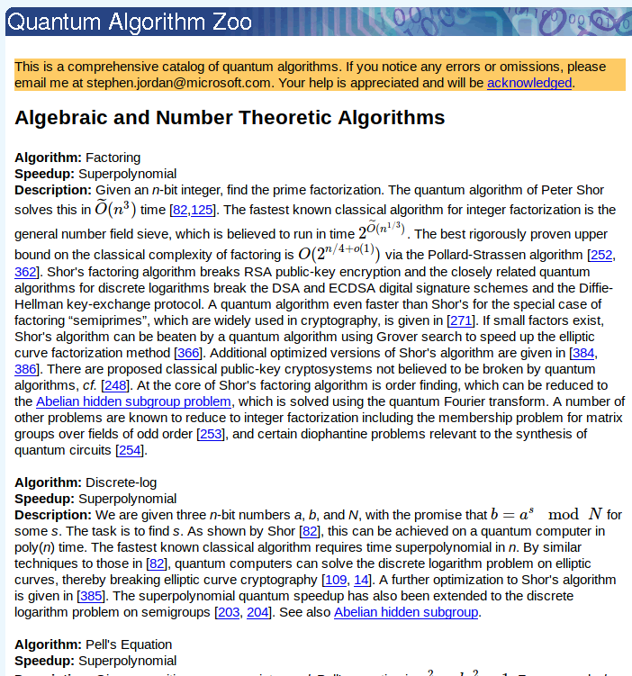
Comparing complexities
Quantum Algorithm Zoo
Reliable: National Institute of Standards & Technology (NIST), USA
Up-to-date: Updated since 2011
(Relatively) structured: Best classical algorithm vs. best quantum algorithm
https://math.nist.gov/quantum/zoo/

Slide 6
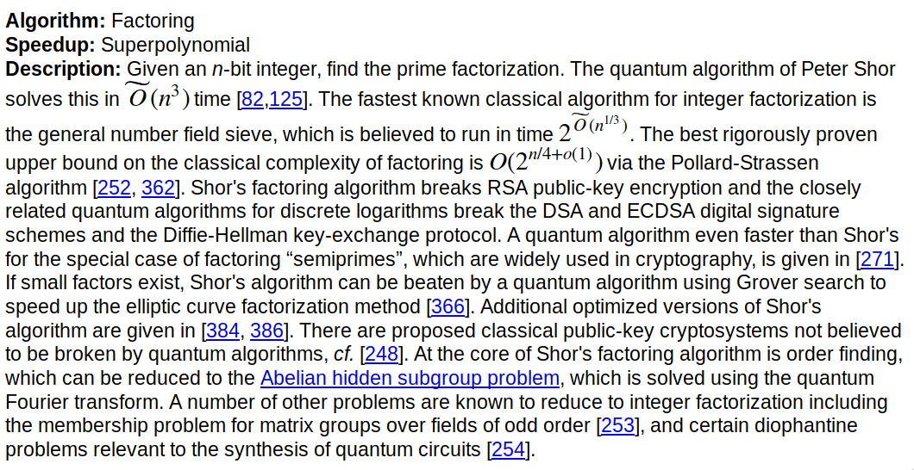
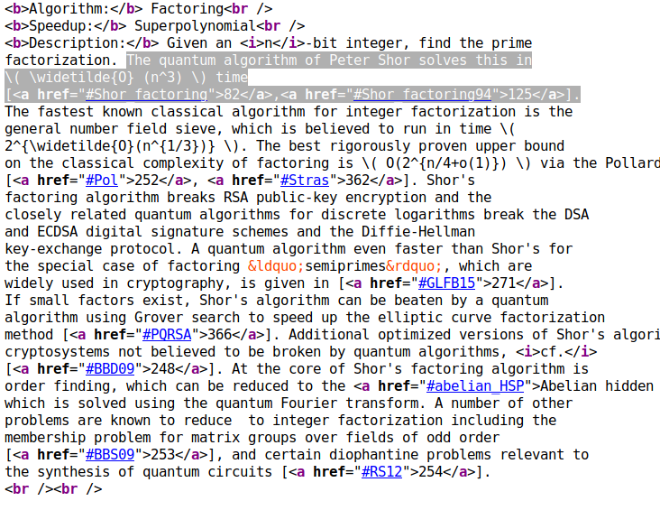
Web scraping: Workflow

Slide 7
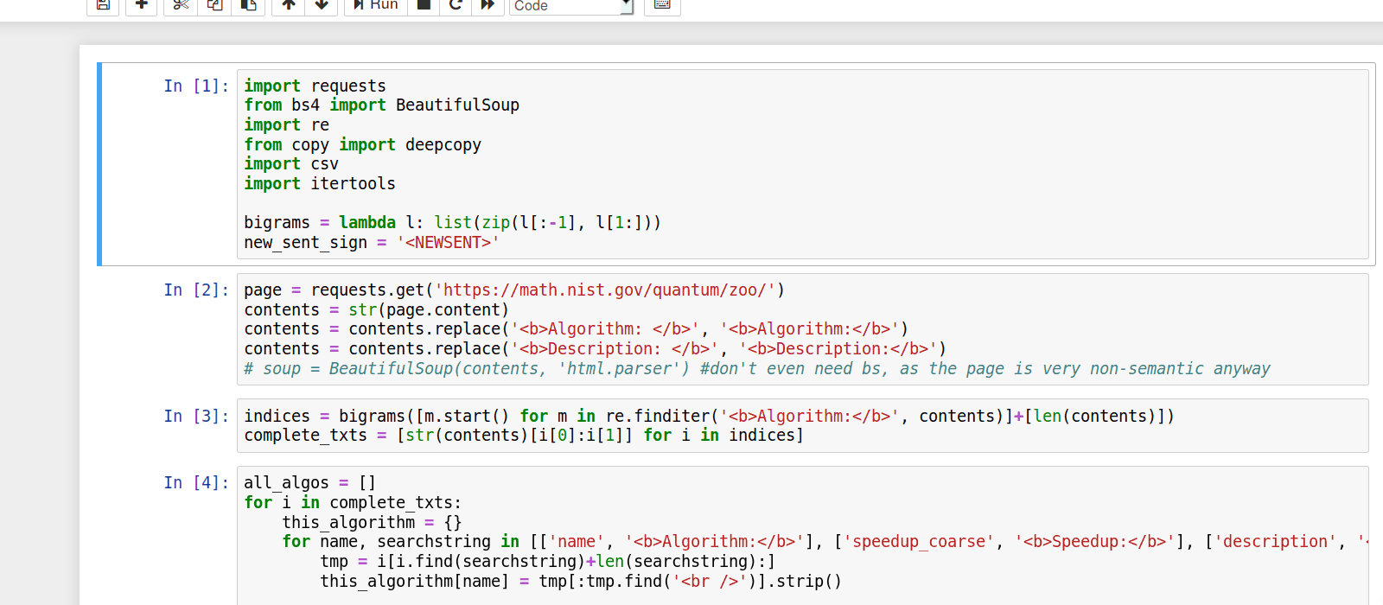
Web scraping: Workflow

Slide 8
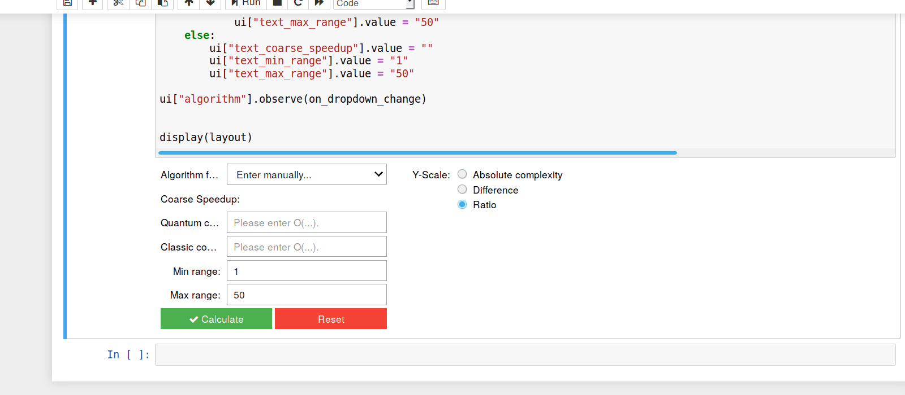
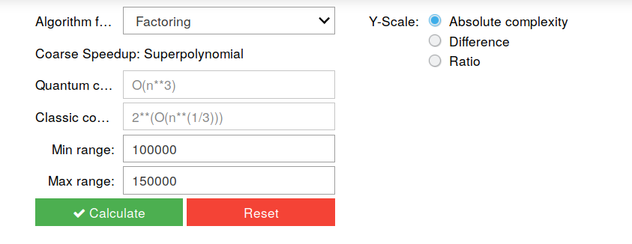
Visualising complexities

Slide 9
Visualising complexities

Slide 10
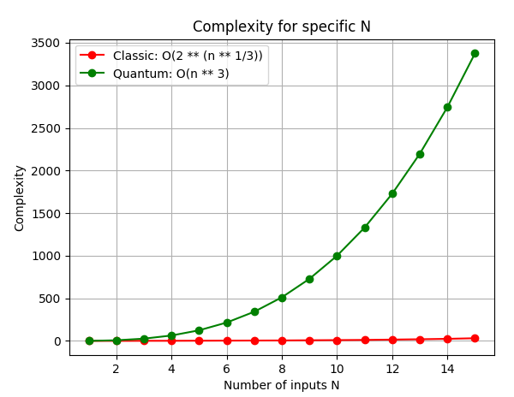
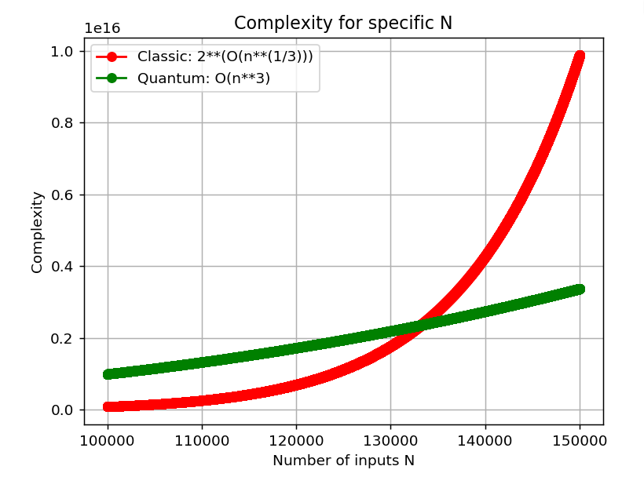
Visualisation: Domain matters!

Slide 11
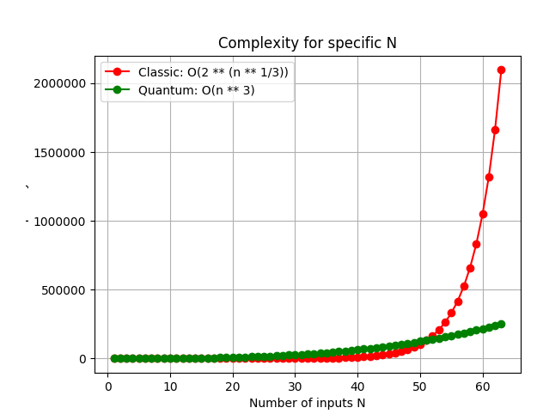
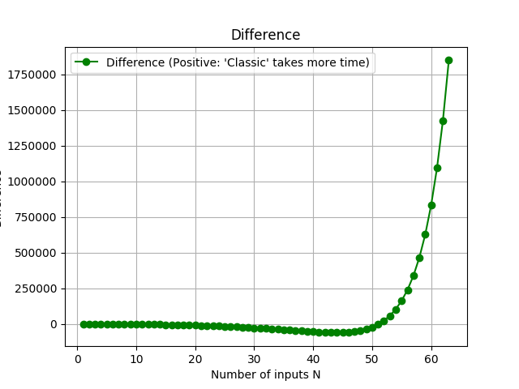
Choose way of visualisation

Slide 12
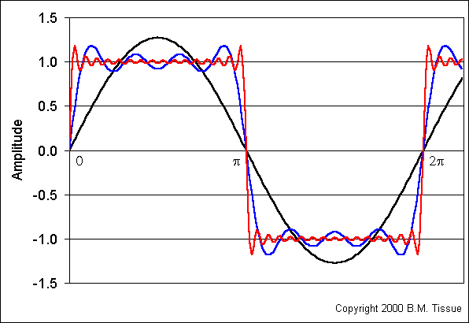
Idea of Fourier Transform
Decompose complex signals into its basic components, e.g. with sin, cos
In order to make it computationally solvable, the signal has to be discretised → leads to the idea of FFT

Slide 13
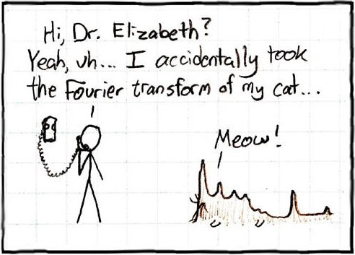
Quantum Fourier Transform
Decomposition of Discrete Fourier Transformation into the product of unitary matrices
Can be computed more efficiently by using quantum gates
→ Combination of Hadamard Gates and Conditional Phase Rotations

Slide 14
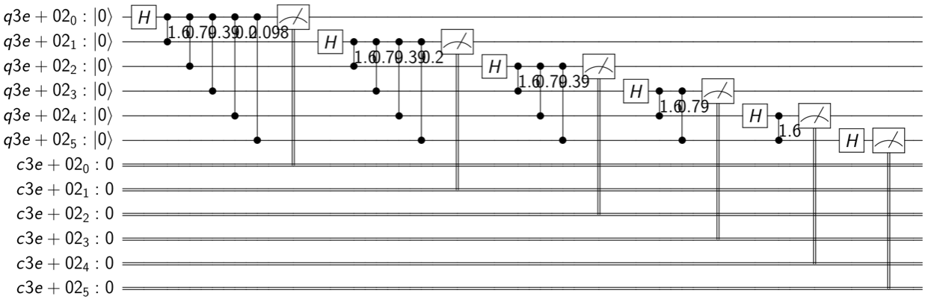
Circuit for Quantum Fourier Transform

Slide 15
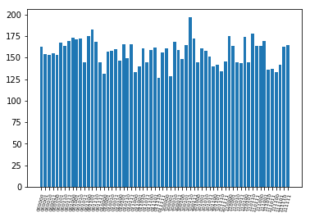
Result for multiple tries
Example with all inputs set to zero
Simulated with 30000 shots

Slide 16
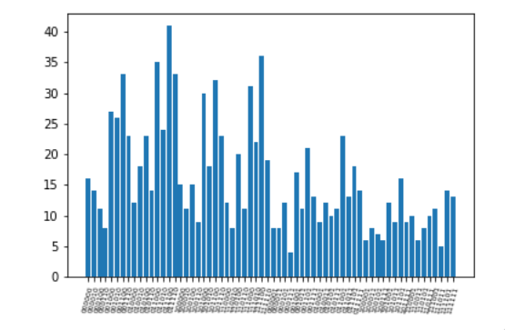
Result for multiple tries
Same run on a Quantum computer
Simulated with 1024 shots

Slide 17
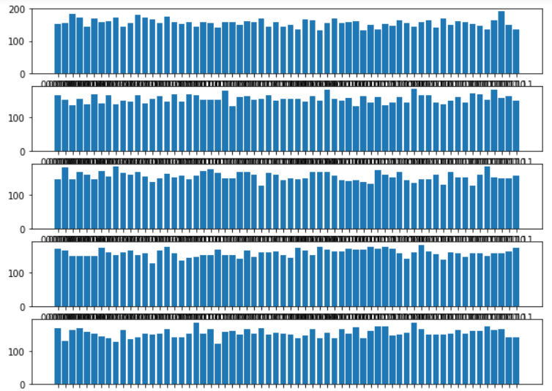
Result for multiple tries with different initialisations
How can we achieve different initialisations? → by inverting some qubits
As you can see, different initialisations have no impact, all results are uniformly distributed

Slide 18
Result for multiple tries with entanglement
How can we achieve entanglement? → applying CNOT Gates
But simple entanglement has no impact, because all results are still equally distributed

Slide 19
Which quantum gates are necessary for...
Classical computation | Probabilistic Computation | Quantum Computation
CNOT 180° rotation | CNOT 180° rotation Hadamard | CNOT Hadamard Phase Shift

Slide 20
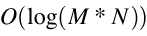

Quantum machine learning: SVM
Classical method of Data Mining and Artificial Intelligence
Complexity: High possible speed-up (M: Samples, N: Features)
Classical:
Quantum:
Rebentrost, P.; Mohseni, M. & Lloyd, S.Quantum support vector machine for big feature and big data classification. arXiv:1307.0471, 2013.

Slide 21
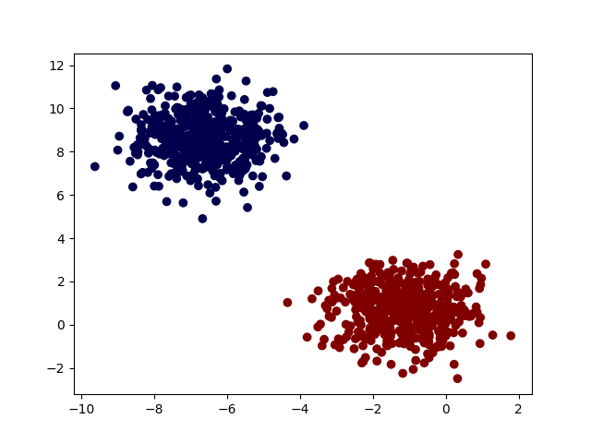
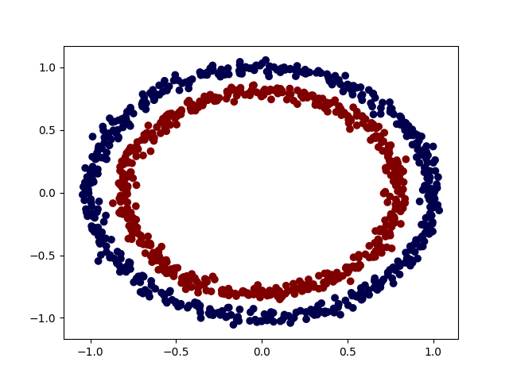
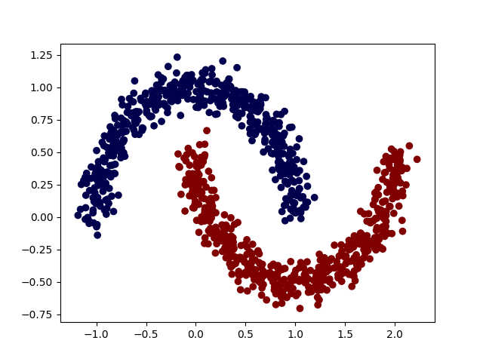
SVM: Testing with custom data

Slide 22
Thanks for your attention!

